Slide 1
Making Data Science Software in Groups
Dr Colin Johnson

Slide 2
Aims
The aim of today is to understand how we can make data science software in groups of people
We will cover a wide range of ideas about this, but we want to focus on two ideas:
Using version control systems so that multiple people can work on the code and data for a single project without confusion
Using software interfaces so that different teams can work on different parts of a project independently
We will start with an overview, and then spend the rest of the day doing two practical tasks about these topics

Slide 3
Structure
10:05-11:00 Introductory talk: Making Software in Groups
11:00-11:10 Short break
11:10-13:00 Individual practical task: version control and source code management
13:00-14:00 Break
14:00-14:10 Introduction to team practical task: writing code to a shared interface
14:10-15:00 Team practical task
15:00-15:10 Short break
15:10-15:45 Team practical task continued
15:45-16:00 Wrap-up

Slide 4
Photographer
A photographer will be visiting the class this afternoon to take photos for the University website.
If you do not want to be in photos, let us know before the afternoon break.

Slide 5
Coverage
K4.5. Development standards, including programming practice, testing, source control.
S2. Perform data engineering: create and handle datasets for analysis. Use tools and techniques to source, access, explore, profile, pipeline, combine, transform and store data, and apply governance (quality control, security, privacy) to data.
S3. …Develop reproducible analysis and robust code, working in accordance with software development standards, including security, accessibility, code quality and version control.
B3. Adaptability and dynamism when responding to varied tasks and organisational timescales, and pragmatism in the face of real-world scenarios.

Slide 6
Introductory Talk: Making Software in Groups

Slide 7
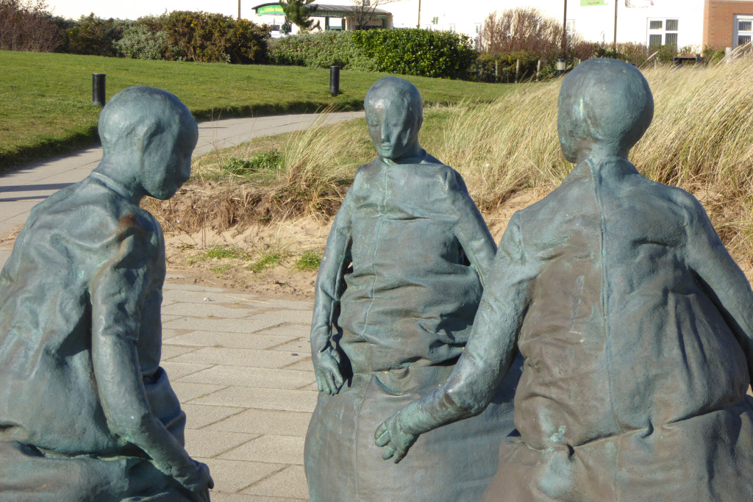
Prioritising
Dividing up work
Estimating
Working together to write code
Interfaces
Pair programming/ code reviews
Storing and modifying code

Slide 8

Deciding what to work on

Slide 9
Dividing up work
Key reason for working a groups—creating code on a larger scale than individuals.
Possible ways to divide up code:
Front end/back end
Separating out separate tasks such as doing graphic design
Model-view-controller
More generally, items of code where information needs to be exchanged a lot and which don’t communicate much outside of that
Loose coupling, tight cohesion
Who “owns” a component?
Prioritising:
Code delivers requirements
Minimum viable product (MVP)

Slide 10
Code Delivers Requirements
Programs are written to do something.
…often called requirements, or product backlog.
You should have some sense of priority in these requirements:
...you might not get them all done
…you typically users to start using a program early
“must have, should have, could have, and won't have”
Example:
Must have: a basic version of the game must be playable
Should have: players can log in an track their scores
Could have: integration with social networks
Won’t have: multi-player game

Slide 11
Code delivers Requirements
These priorities might be internally generated…
…or might come from outside.
Idea of the “minimum viable product” or “minimum marketable product”
These set coding priorities

Slide 12
Sprints
“Code delivers requirements.”
Keep units small: deliver one decently-sized requirement, over a few days of work (5-20).
In the Scrum way of working, these are called sprints
At the end, the new code should be incorporated into a working version of the whole program—and tested.
This prevents the program fissipating into lots of part-completed sections.
Also prevents the “fog of bullshit” where everyone asserts that their component is working, and that everyone else needs to sort their bit out.
Working code in context is an honesty check.

Slide 13
Structure of Scrum-like Sprints
Image from https://www.scrum.org

Slide 14
Structure of Scrum-like Sprints
Image from https://www.scrum.org

Slide 15
Structure of Scrum-like Sprints
Image from https://www.scrum.org

Slide 16
Structure of Scrum-like Sprints
Image from https://www.scrum.org

Slide 17

Agreeing how your code will communicate

Slide 18
“Loose coupling, tight cohesion”
Each person takes on responsibility for one part of the database and its GUI components in different languages for different devices
One person takes on the back-end database;
Another the input forms;
Another the display of the product photos and information;
Another the language localisation…
vs.

Slide 19
Example: Specifying an Interface
Object
Customer database
Input
String: customer email address (unique ID)
String: new postcode
String (optional; if absent then NULL): House number
Behaviour
Attempts to update customer address.
Outputs
Boolean: True if postcode/number is verified, False otherwise
String (optional; if absent then NULL): nearest match if the postcode/number absent.

Slide 20
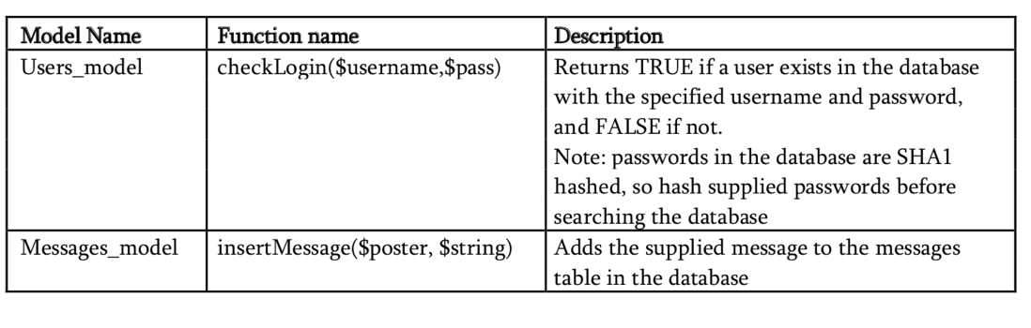
Another Example

Slide 21
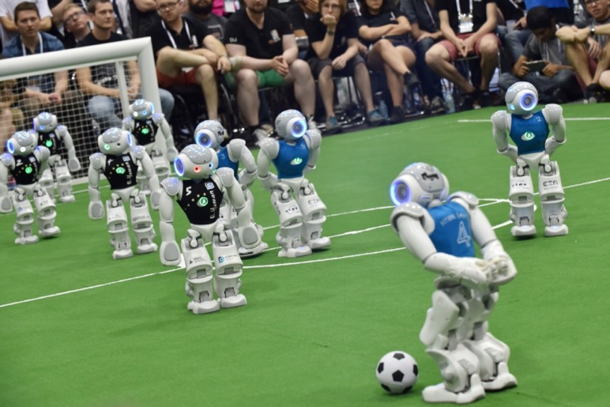
Another Example: RoboCup

Slide 22
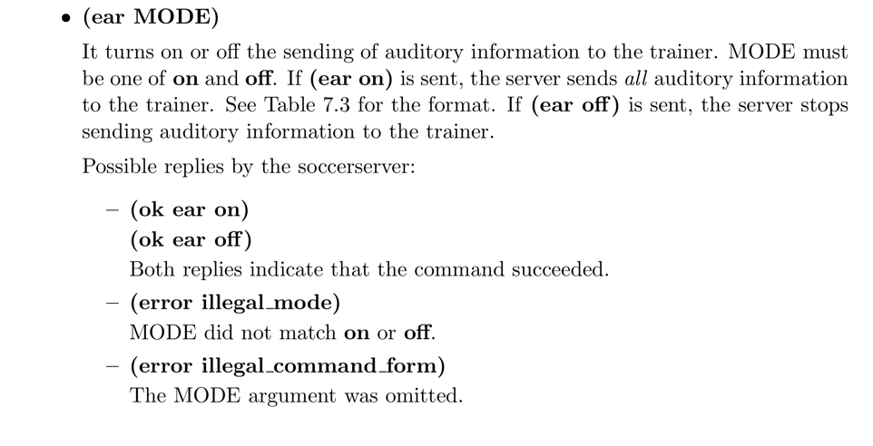
Another Example: RoboCup

Slide 23
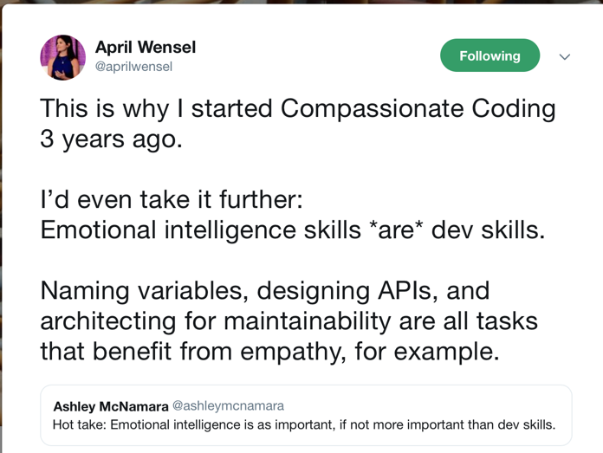
Emotional Intelligence Skills are Development Skills

Slide 24
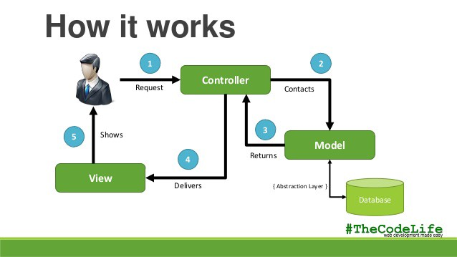
Model-View-Controller

Slide 25

Storing and modifying code

Slide 26


Email Attachments/Physical Sharing
Prehistoric sharing technologies: mail attachments; physical, such as flash drive

Slide 27
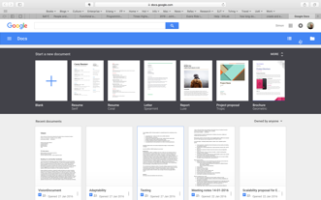
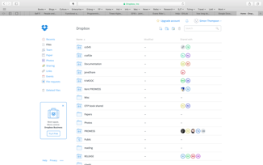
Cloud Sharing
Google docs: shared editing
Dropbox: Shared directory and some change management
Neither of these helps us to …
… resolve conflicts that arise … document the changes made … manage issues that arise

Slide 28
Version Control aka Source Code Management
We want to have a single copy of the code we area working on together.
We also want to keep track of the changes so that we can look back, rewind, and understand why other people have made changes.
Version control systems such as git allow us to do this.
These might be public/cloud services:
GitHub/Bitbucket—freemium services
…or you can host it yourself
E.g. we do this here at Nottingham: https://git.cs.nott.ac.uk/

Slide 29
Version Control aka Source Code Management
Also important for legal and practical reasons
The code/data across the team is all in one place—it isn’t on individual people’s machines. Gives robustness.
Ensures that it is easy to enforce laws about data privacy and freedom of information. The data is in a centralized place, so if a request comes into the organization for a review of personal data, or a subject access request for FoI, then there is a limited number of places where that data might be.

Slide 30
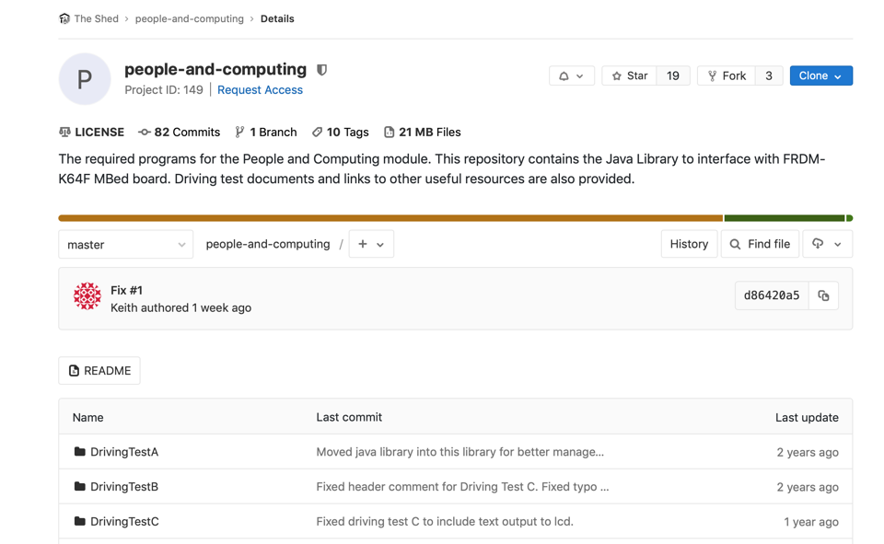
Version Control: Git and so on

Slide 31


Simplest Model: Lock/Modify/Unlock
But, does this scale as more people work on the code?

Slide 32
Automated merge
Copy / modify / merge – scenario 1

Slide 33
Conflict!
Copy / modify / merge – scenario 2
Images from image.shutterstock.com

Slide 34
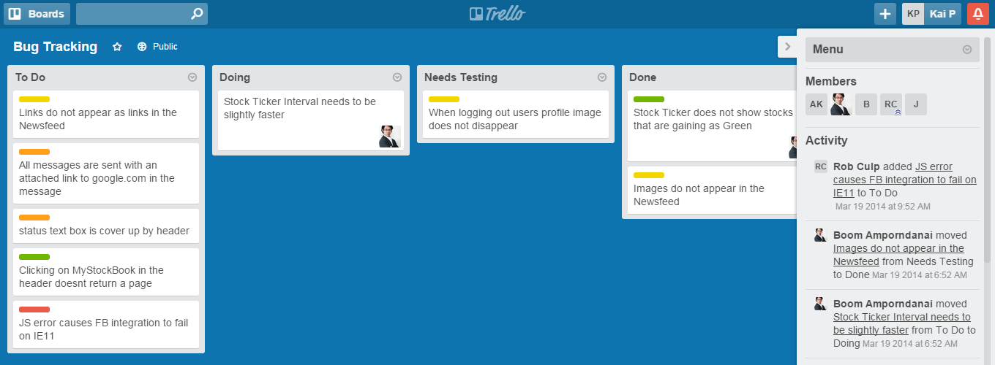
Bug Tracking

Slide 35
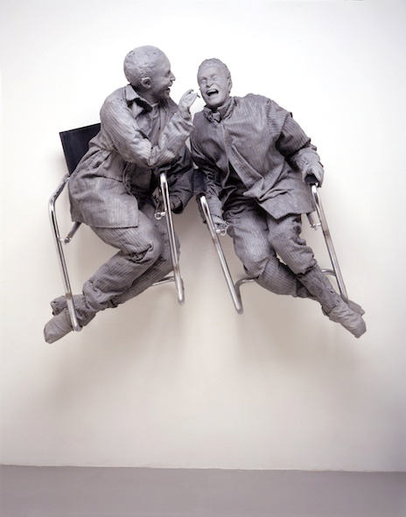
Working on code together

Slide 36
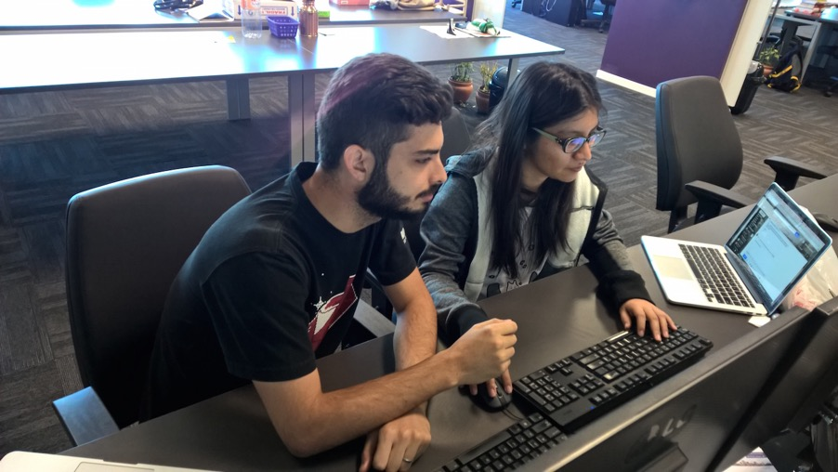
Pair Programming/Code Reviews

Slide 37
Pair Programming
Two people working at one machine
One is the Driver and writes the code (including tests etc.), discussing what they are doing out loud
The other is the Navigator and:
Looks over the code for immediate errors
Suggests improvements e.g. in algorithms/libraries
Does research
Is there to discuss ideas
Keeps the project aims in focus
Celebrates success and generates motivation
Regularly swap roles.
Waste of effort? Or, does the increase in quality productivity outweigh the cost?

Slide 38

The “Surgical Team”
Lots of people are involved in surgery, but not everyone is getting in there poking around inside the patient.
Similar for software: not everyone needs to be poking around inside the code at any particular point

Slide 39
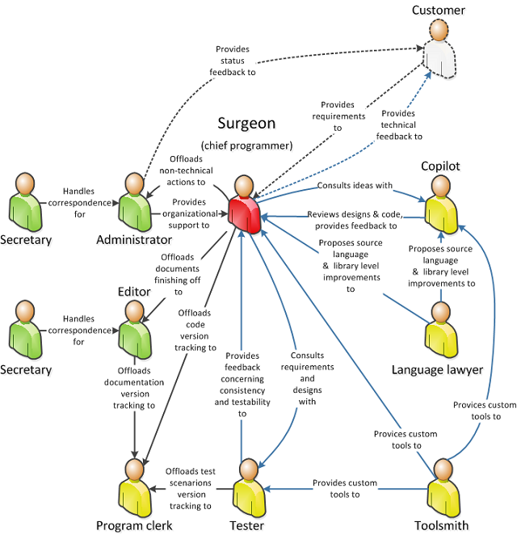
The “Surgical Team”
Lots of people are involved in surgery, but not everyone is getting in there poking around inside the patient.
Similar for software: not everyone needs to be poking around inside the code at any particular point

Slide 40
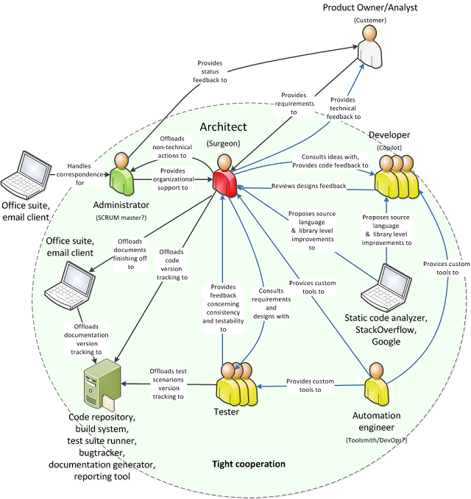
The “Surgical Team”
Lots of people are involved in surgery, but not everyone is getting in there poking around inside the patient.
Similar for software: not everyone needs to be poking around inside the code at any particular point

Slide 41
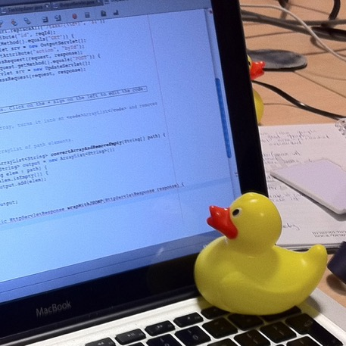
Pair Programming without a Pair!
See https://pragprog.com/book/tpp/the-pragmatic-programmer

Slide 42
Code Reviews
Reviewing code after it has been written
Looking for errors
Writing new tests/test cases
Checking for consistency in style and approach
Simplifying: e.g. replacing bespoke code with libraries

Slide 43
Prioritising
Dividing up work
Estimating
Working together to write code
Interfaces
Pair programming/ code reviews
Storing and modifying code

Slide 44
Short Break

Slide 45
Individual Practical Task

Slide 46
Version Control/Source Code Management
We have briefly discussed version control and source code management earlier
The key idea is that there is a common repository of code (documents, data,…) that is shared on the cloud between a team
Each team member can take a copy of the code, work on it, and then merge their changes back in
Some “intelligent” attempt to manage changes, but overall you should be careful to only modify things that are in your area of responsibility
In this task, we will learn to use the Git source code management system

Slide 47
Tasks
Preliminary: checking that you have access to the GitLab site and that you have appropriate software installed
Basic check in and out of a document
Branch and merge
Creating your own repo
These are on the worksheet on the module Moodle page
Some parts are challenging. We are here to help!

Slide 48
Break

Slide 49
Group Practical Task

Slide 50
Programming Against an Interface
In order to scale up programming, we can use a (software) interface
That is, we agree on the format that our piece of code will receive, and the code it will generate (and, what it will do, of course)
Then, we are free to write our software, and the other team there, and we can bring the two pieces of software together at the end.
…and we can scale this up to a larger number of teams.

Slide 51

Programming Against an Interface
Team 1
Team 2
Interface

Slide 52
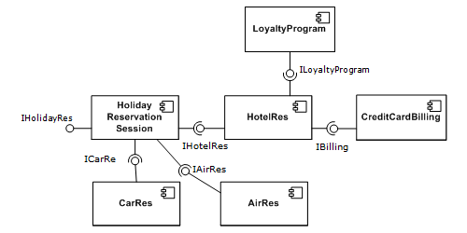
Notation: UML Component Diagram

Slide 53
This Afternoon’s Task
We will practice this this afternoon. Get yourself into teams of around four people, and then split into two sub-teams
Data preprocessing
Data analysis
Then you will work on separate code, one of which is designed to produce a data file in a given specification, the other to receive it.
The scenario is about a collection of customer data for a coffee company
The details on on a worksheet on the module Moodle page

Slide 54
This Afternoon’s Task
We will use GitHub to host the files:
You get the task files from there
You upload your part of the solution to there
There will be two-three people in your team, so practice ideas from pair programming; the people not at the keyboard:
Looks over the code for immediate errors
Suggests improvements e.g. in algorithms/libraries
Does research
Is there to discuss ideas
Keeps the project aims in focus
Celebrates success and generates motivation
There are some hard parts to this task, but we are here to help!

Slide 55
Short Break

Slide 56
This Afternoon’s Task
We will use GitHub to host the files:
You get the task files from there
You upload your part of the solution to there
There will be two-three people in your team, so practice ideas from pair programming; the people not at the keyboard:
Looks over the code for immediate errors
Suggests improvements e.g. in algorithms/libraries
Does research
Is there to discuss ideas
Keeps the project aims in focus
Celebrates success and generates motivation
There are some hard parts to this task, but we are here to help!

Slide 57
Bring your code/data together

Slide 58
Bringing your code/data together
Okay, you should now have finished the task.
Bring your code/data together. See whether the code written by the data analysis sub-team works with the data generated by the preprocessing sub-team
If there are problems, why didn’t it work?
Was something under-specified in the interface?
Was the interface sufficient for you to work alone, or did you want to talk to the other sub-team?

Slide 59
Wrapup

Slide 60
Key Ideas
Working on code in groups:
Dividing up work
Splitting up code via a mutually agreed (or top-down) interface
Storing and sharing code via a source code management/version control system
Pair programming and other ways of working together
We should have learned:
The basics of the Git source code management system
Some practical ideas about programming to an interface

Slide 61

Reminder: Assessment 1

Slide 62
Assessment 1
A reminder that Assessment 1 for this module is now available from the module Moodle page.

Slide 63
Closing

